Slide 1


Class 2: Neural Network Basics
Andrew Parnell

Slide 2
Learning outcomes
Understand what neural networks are and how they create predictions
Build a small neural network step by step
Practice dot products, linear transforms, and activations by hand
Prepare for coding NNs in the next session

Slide 3
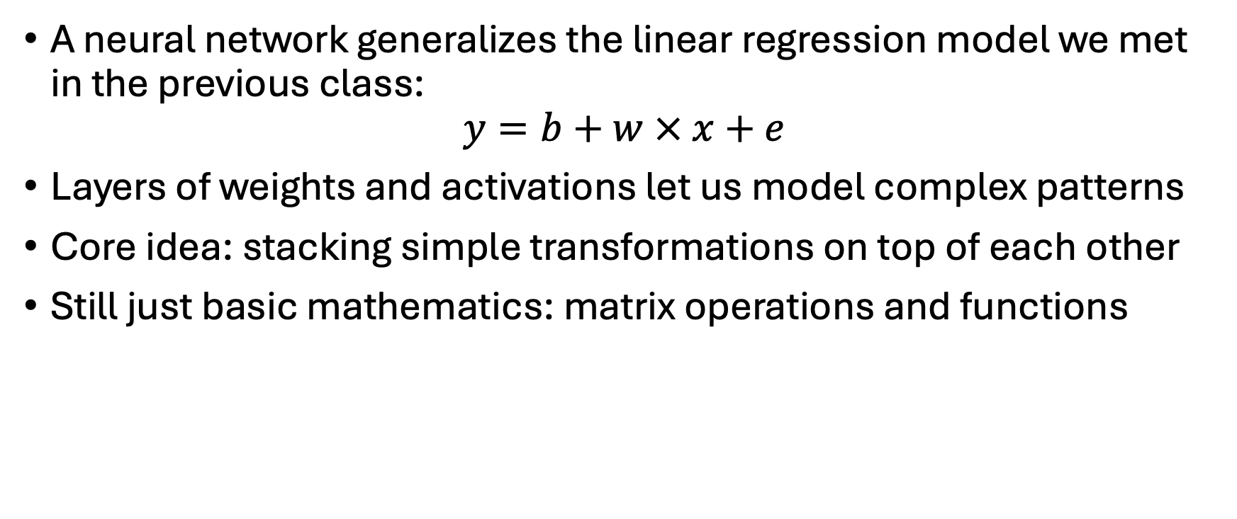
Foundations of Neural Networks (NNs)
A neural network generalizes the linear regression model we met in the previous class:
$$y=b+w × x+e$$
Layers of weights and activations let us model complex patterns
Core idea: stacking simple transformations on top of each other
Still just basic mathematics: matrix operations and functions

Slide 4
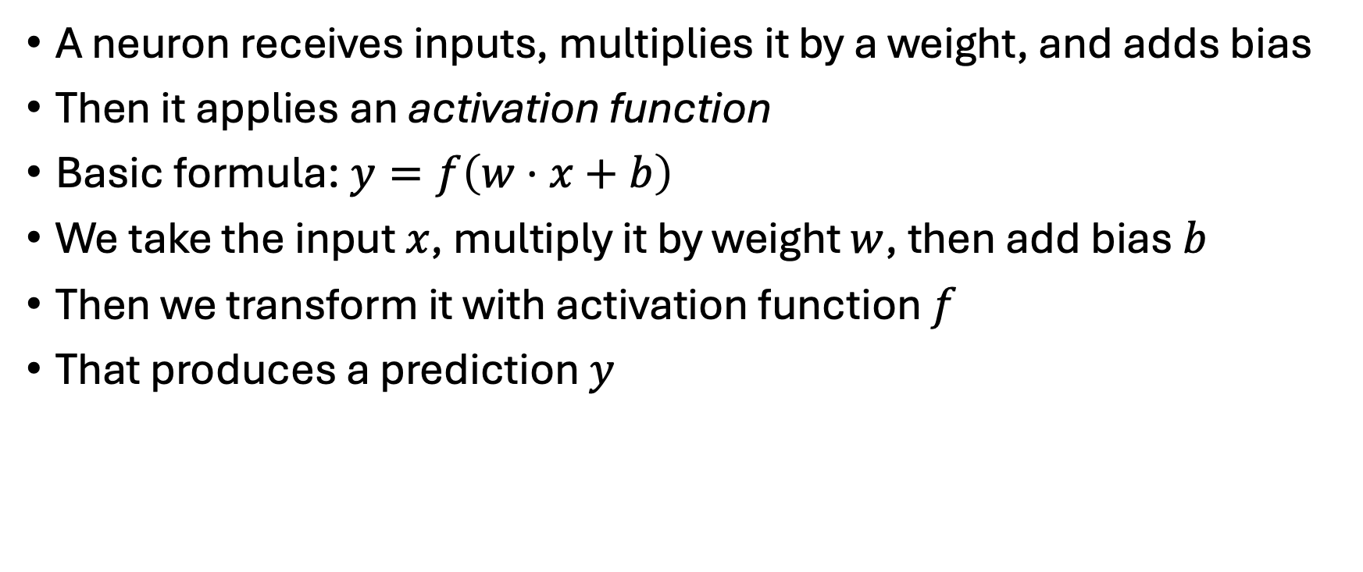
Neurons
A neuron receives inputs, multiplies it by a weight, and adds bias
Then it applies an activation function
Basic formula:$y=f\left(w⋅x+b\right)$
We take the input $x$, multiply it by weight $w$, then add bias $b$
Then we transform it with activation function $f$
That produces a prediction $y$

Slide 5
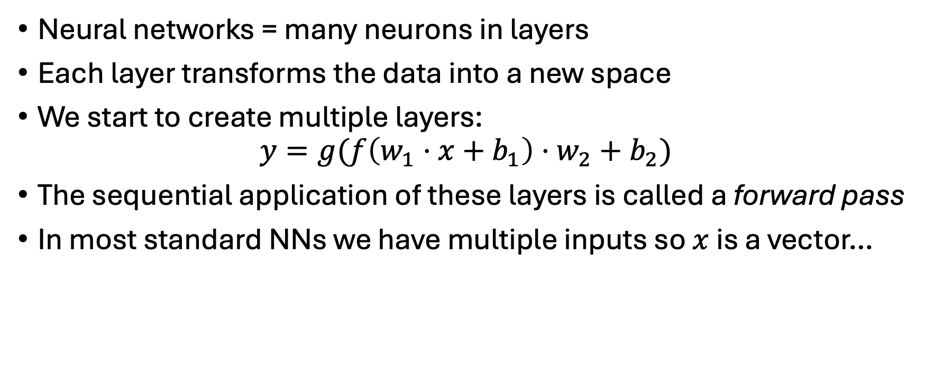
Networks as compositions
Neural networks = many neurons in layers
Each layer transforms the data into a new space
We start to create multiple layers:
$$y=g(f\left(w_{1}⋅x+b_{1}\right)⋅w_{2}+b_{2})$$
The sequential application of these layers is called a forward pass
In most standard NNs we have multiple inputs so $x$ is a vector…

Slide 6
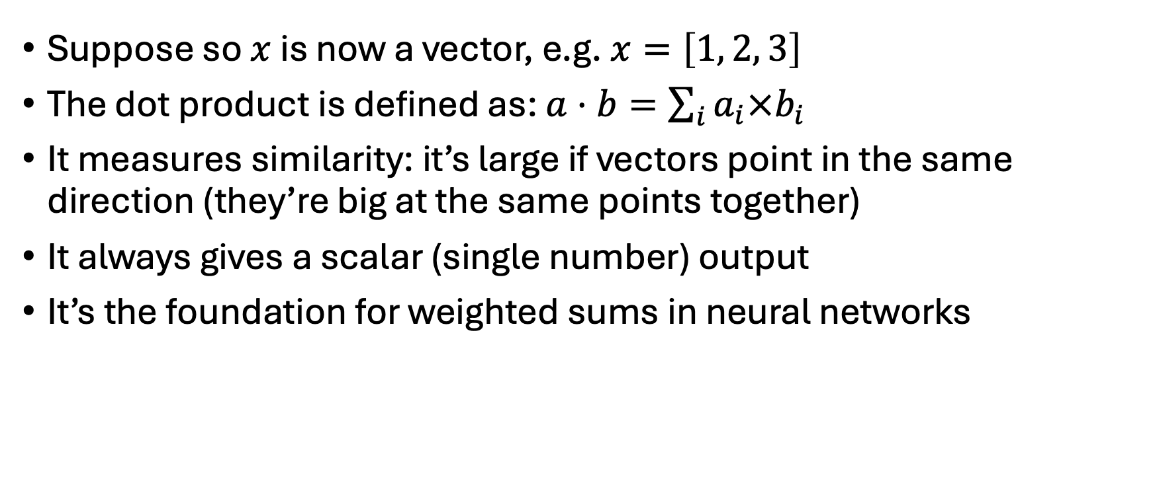
Dot Products
Suppose so $x$ is now a vector, e.g. $x=\left[1, 2, 3\right]$
The dot product is defined as: $a⋅b=\sum_{i}{a_{i}×b_{i}}$
It measures similarity: it’s large if vectors point in the same direction (they’re big at the same points together)
It always gives a scalar (single number) output
It’s the foundation for weighted sums in neural networks

Slide 7
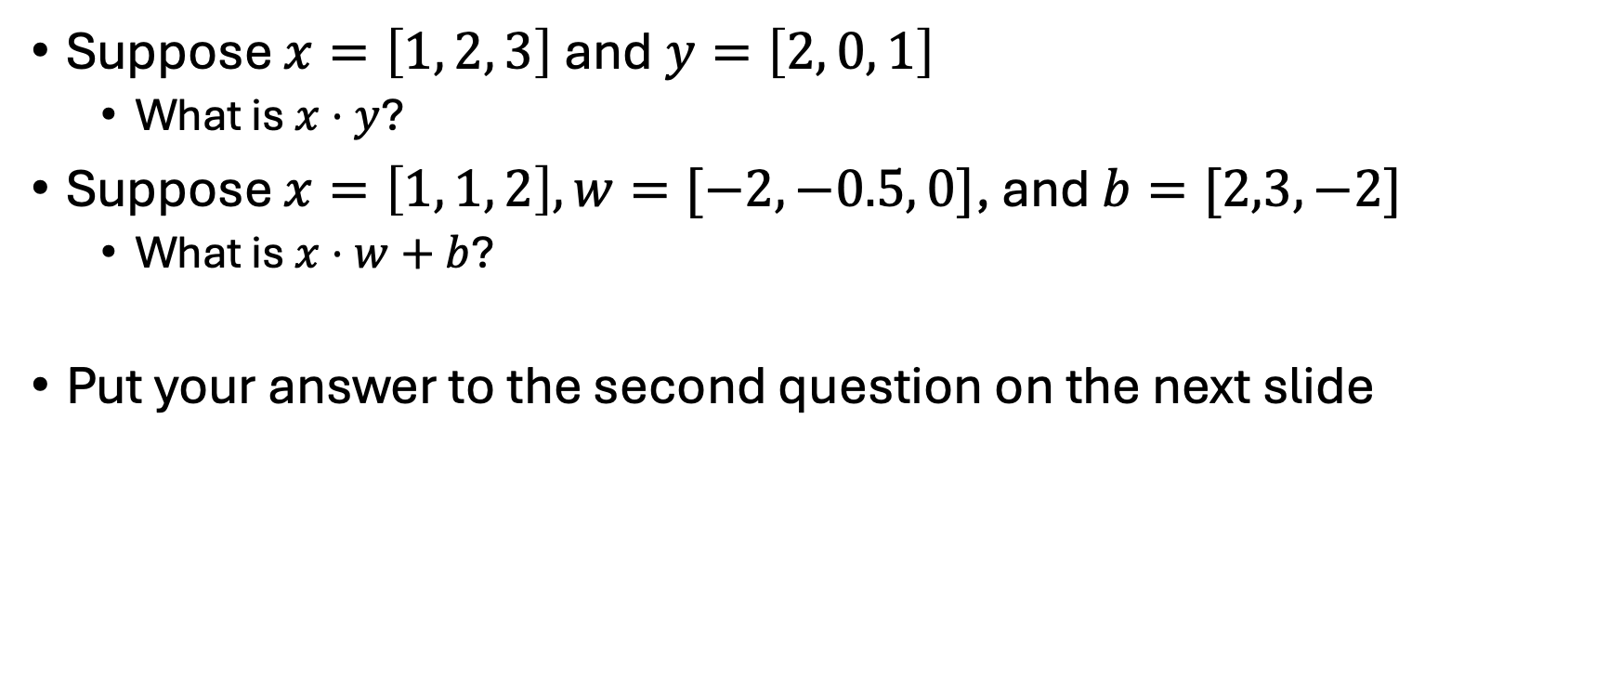
Dot product quiz
Suppose $x=\left[1, 2, 3\right]$ and$y=\left[2, 0, 1\right]$
What is $x⋅y$?
Suppose $x=\left[1, 1, 2\right], w=[−2, −0.5, 0]$, and $b=[2,3,−2]$
What is $x⋅w+b$?
Put your answer to the second question on the next slide

Slide 8
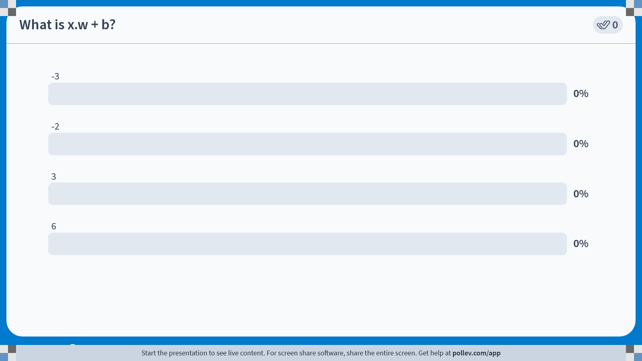
Notes:
Do not modify the notes in this section to avoid tampering with the Poll Everywhere activity. More info at polleverywhere.com/support What is x.w + b?
https://www.polleverywhere.com/multiple_choice_polls/4tZfddIIaHdmsw4Tl8Mqu?state=opened&flow=Default&onscreen=persist

Slide 9
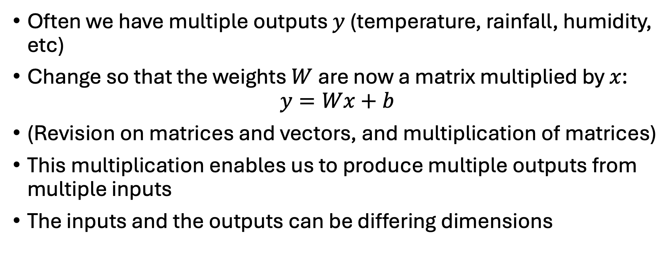
Multiple outputs
Often we have multiple outputs $y$ (temperature, rainfall, humidity, etc)
Change so that the weights $W$ are now a matrix multiplied by $x$:
$$y=Wx+b$$
(Revision on matrices and vectors, and multiplication of matrices)
This multiplication enables us to produce multiple outputs from multiple inputs
The inputs and the outputs can be differing dimensions

Slide 10
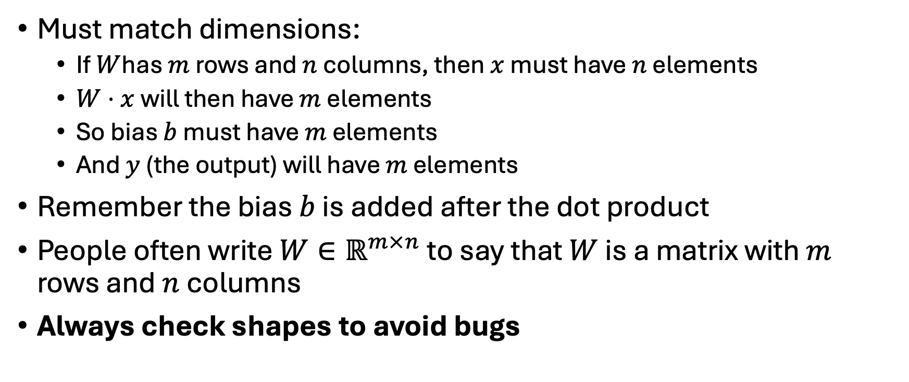
Matrix Shapes and Rules
Must match dimensions:
If $W$has $m$ rows and $n$ columns, then $x$ must have $n$ elements
$W⋅x$ will then have $m$ elements
So bias $b$ must have $m$ elements
And $y$ (the output) will have $m$ elements
Remember the bias $b$ is added after the dot product
People often write $W∈ℝ^{m×n}$ to say that $W$ is a matrix with $m$ rows and $n$ columns
Always check shapes to avoid bugs

Slide 11
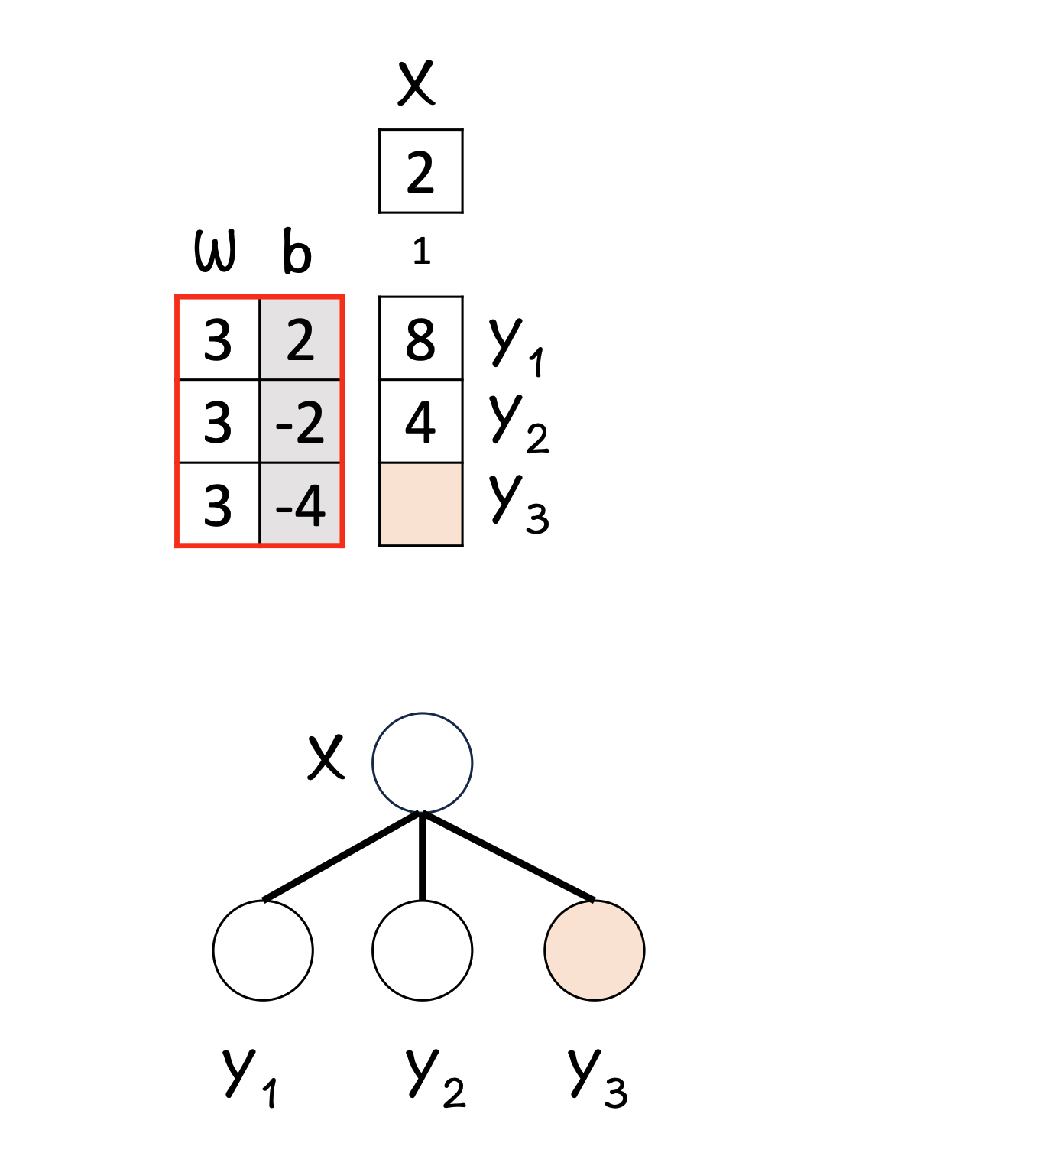
Hands-On: Linear Layer Example
Walk through one full forward pass manually
Remember element-wise steps: multiply → sum up → add bias
Check shape before and after to see if it makes sense

Slide 12
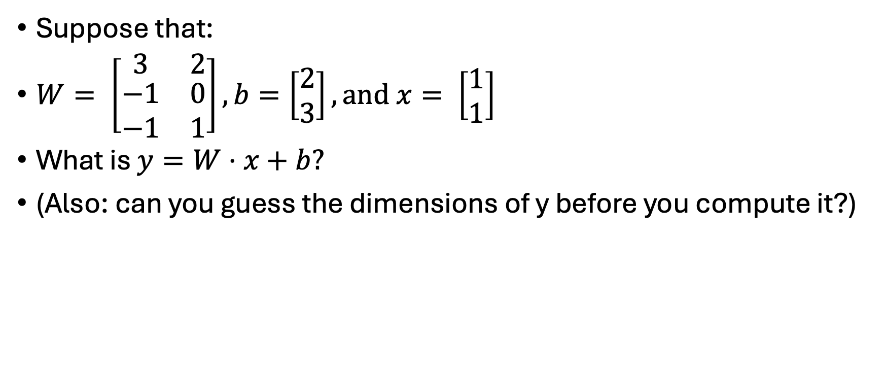
Can you do these?
Suppose that:
$W= \left[\begin{matrix}3 & 2 \\ \begin{aligned}−1 \\ −1\end{aligned} & \begin{aligned}0 \\ 1\end{aligned}\end{matrix}\right], b=\left[\begin{matrix}2 \\ 3\end{matrix}\right], and x= \left[\begin{matrix}1 \\ 1\end{matrix}\right]$
What is $y=W⋅x+b?$
(Also: can you guess the dimensions of y before you compute it?)

Slide 13
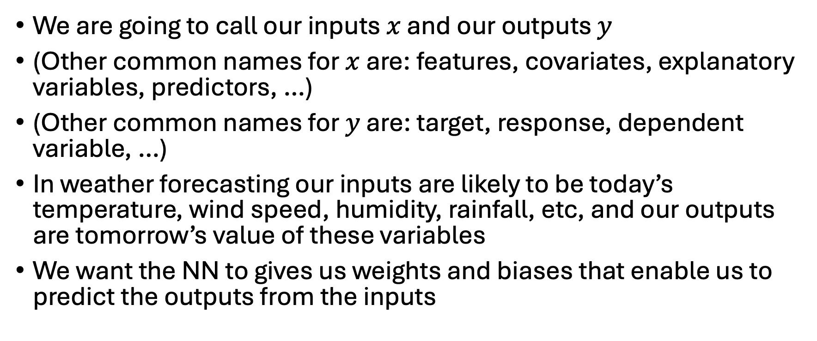
How does this link to weather and climate?
We are going to call our inputs $x$ and our outputs $y$
(Other common names for $x$ are: features, covariates, explanatory variables, predictors, …)
(Other common names for $y$ are: target, response, dependent variable, …)
In weather forecasting our inputs are likely to be today’s temperature, wind speed, humidity, rainfall, etc, and our outputs are tomorrow’s value of these variables
We want the NN to gives us weights and biases that enable us to predict the outputs from the inputs

Slide 14
Hidden layers
NNs often represented in a picture that shows how the layers link together
Here’s one for the linear regression we fitted in the last class:

Slide 15
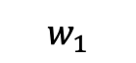


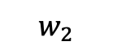
Increasing the number of hidden layers
NNs often represented in a picture that shows how the layers link together
Here’s one for the linear regression we fitted in the last class:
x₁
$$w_{1}$$
x₂
$$\hat{y}$$
$$w_{2}$$
$$b$$
1

Slide 16
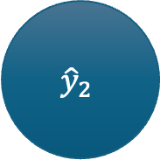
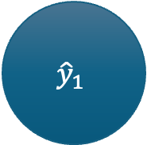
Increasing the number of hidden layers 2
Now suppose we had multiple outputs:
Each line has a weight associated with it
x₁
$${\hat{y}}_{1}$$
x₂
$${\hat{y}}_{2}$$
1

Slide 17



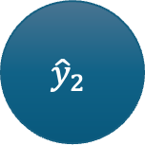
Increasing the number of hidden layers 2
And now suppose we created some extra layers
Note (most graphs ignore the biases)
x₁
$${\hat{h}}_{1}$$
$${\hat{y}}_{1}$$
x₂
$${\hat{h}}_{2}$$
$${\hat{y}}_{2}$$
1
1

Slide 18
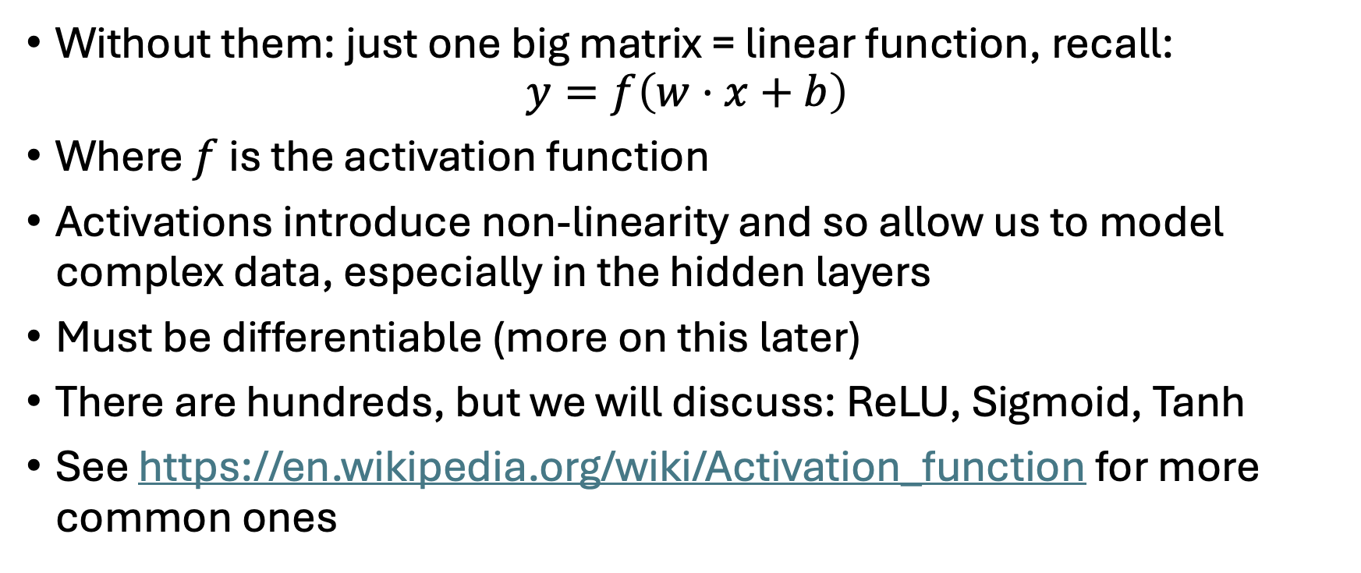
Activation functions
Without them: just one big matrix = linear function, recall:
$$y=f\left(w⋅x+b\right)$$
Where $f$ is the activation function
Activations introduce non-linearity and so allow us to model complex data, especially in the hidden layers
Must be differentiable (more on this later)
There are hundreds, but we will discuss: ReLU, Sigmoid, Tanh
See https://en.wikipedia.org/wiki/Activation_function for more common ones

Slide 19
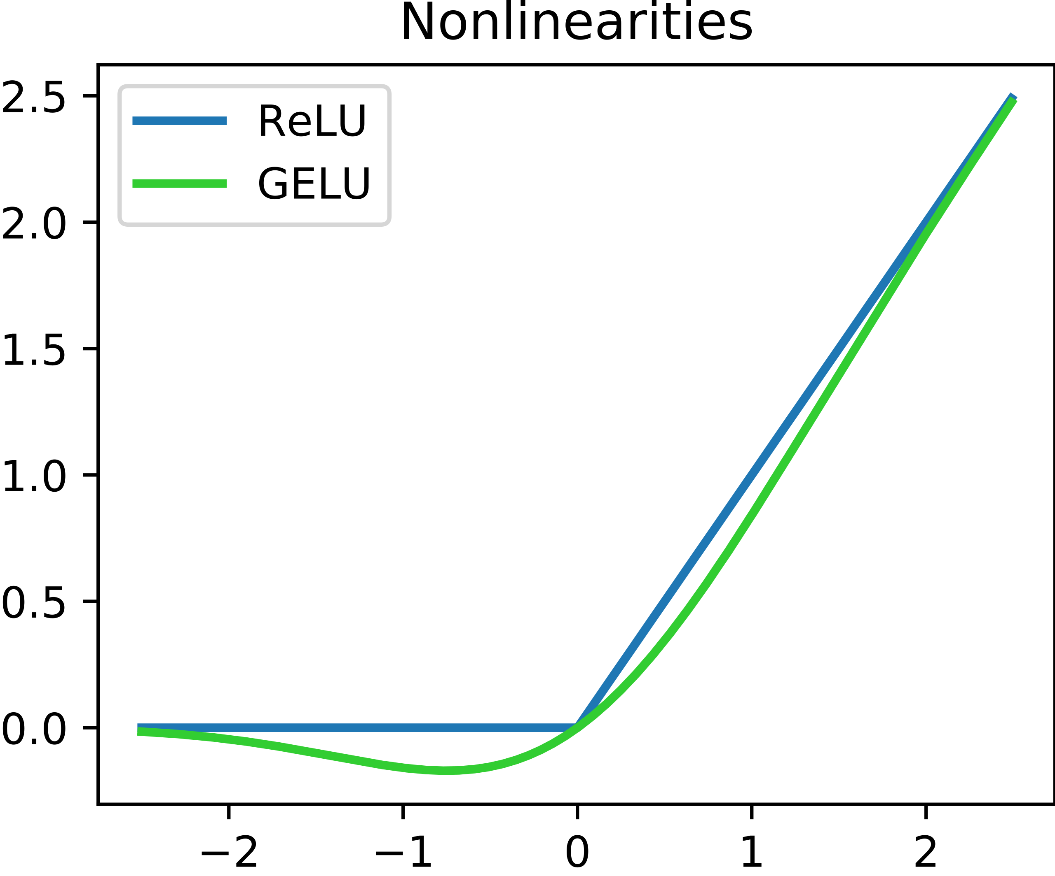
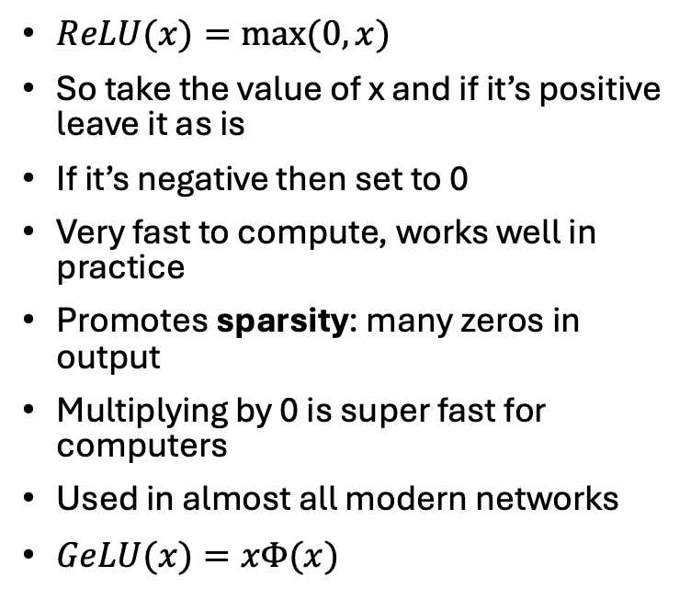
ReLU – Rectified Linear Unit
$ReLU(x)=max⁡(0,x)$
So take the value of x and if it’s positive leave it as is
If it’s negative then set to 0
Very fast to compute, works well in practice
Promotes sparsity: many zeros in output
Multiplying by 0 is super fast for computers
Used in almost all modern networks
$GeLU(x)=xΦ(x)$
From https://en.wikipedia.org/wiki/Rectifier_(neural_networks)

Slide 20
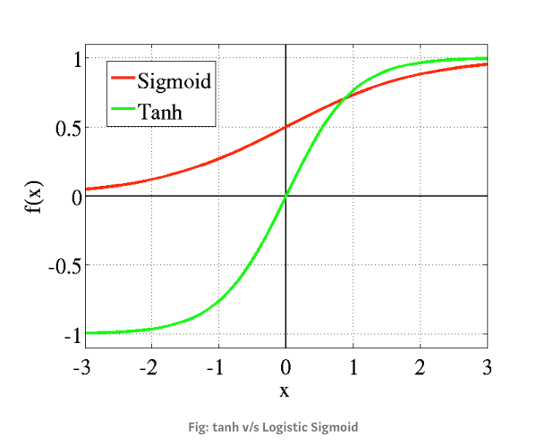
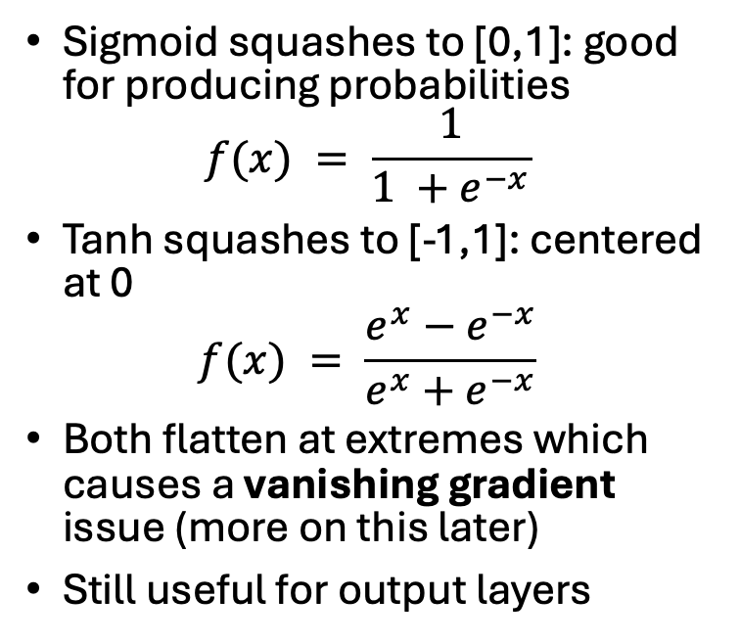
Sigmoid and tanh
Sigmoid squashes to [0,1]: good for producing probabilities
$$f(x) = \frac{1}{1 +e^{−x}}$$
Tanh squashes to [-1,1]: centered at 0
$$f(x) = \frac{e^{x}−e^{−x}}{e^{x}+e^{−x}}$$
Both flatten at extremes which causes a vanishing gradient issue (more on this later)
Still useful for output layers
From https://miro.medium.com/v2/resize:fit:1280/1*R2e5_A-hD3VB3B1wv3qaQA.png

Slide 21
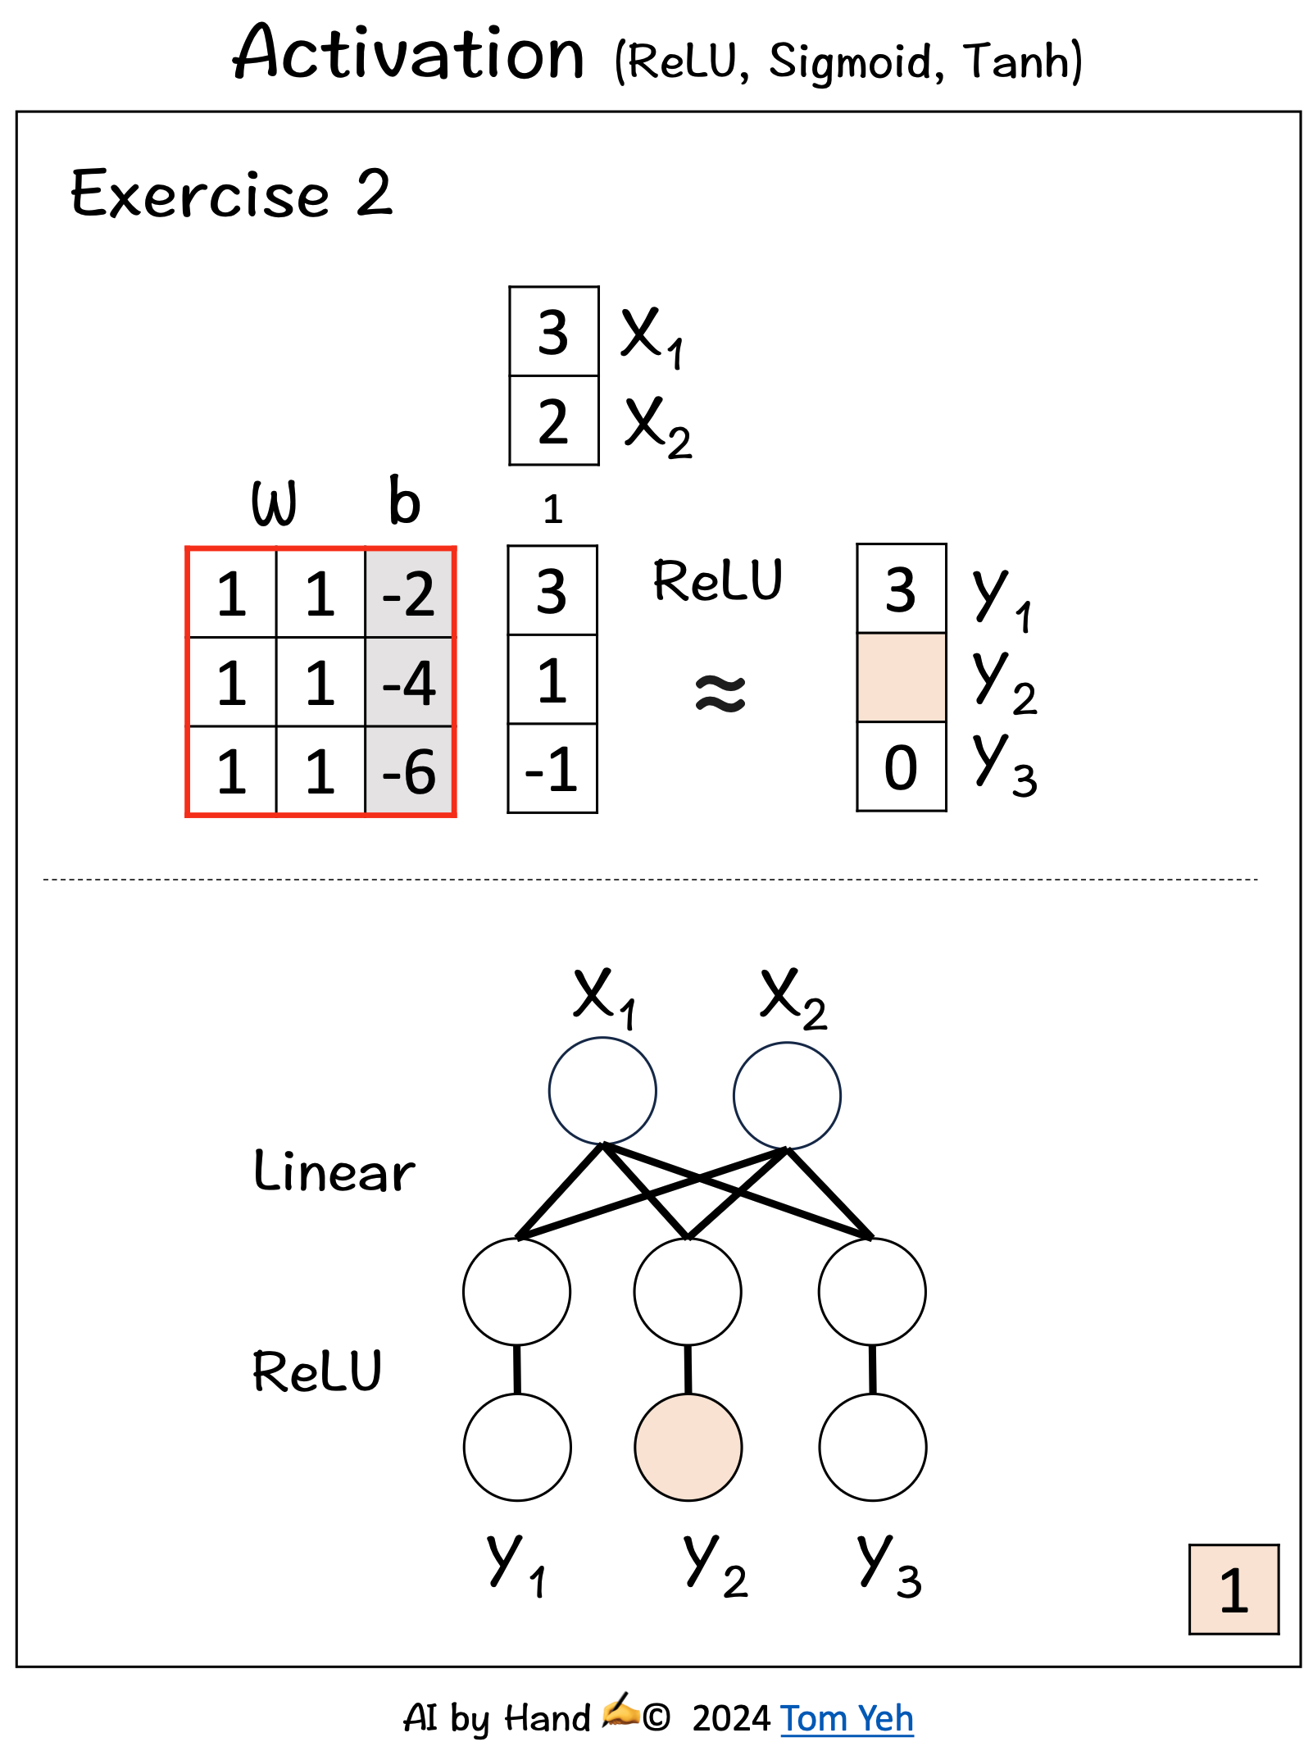
Activation Practice
See the example opposite
Same process, one extra step: input, weight, bias → compute pre-activation → apply function
Could also apply sigmoid or tanh activation functions
What differences do you observe?

Slide 22
Building a simple network
Input: 2-d vector x
Linear transform: W, b
ReLU activation
Output: 2-d hidden representation

Slide 23
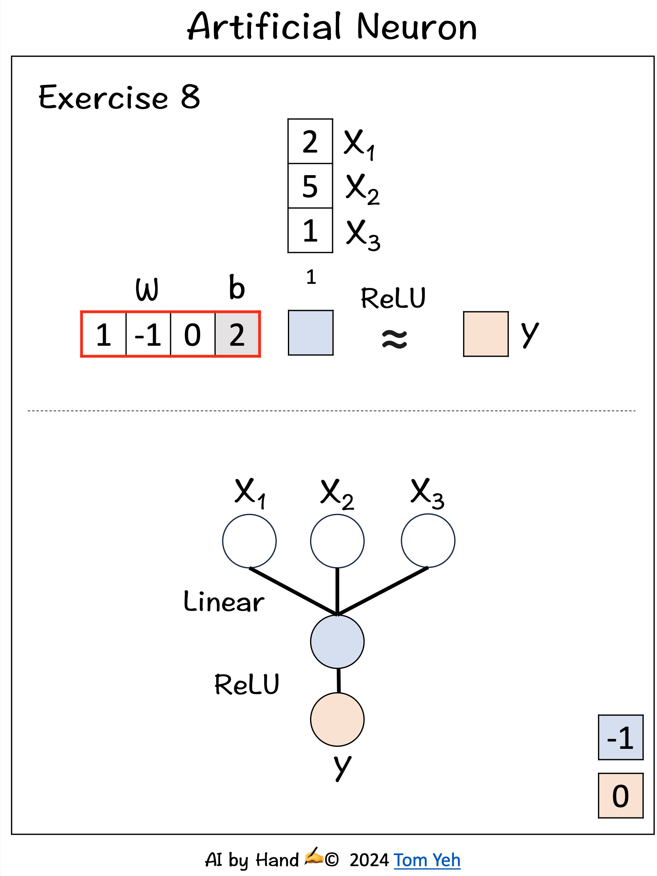
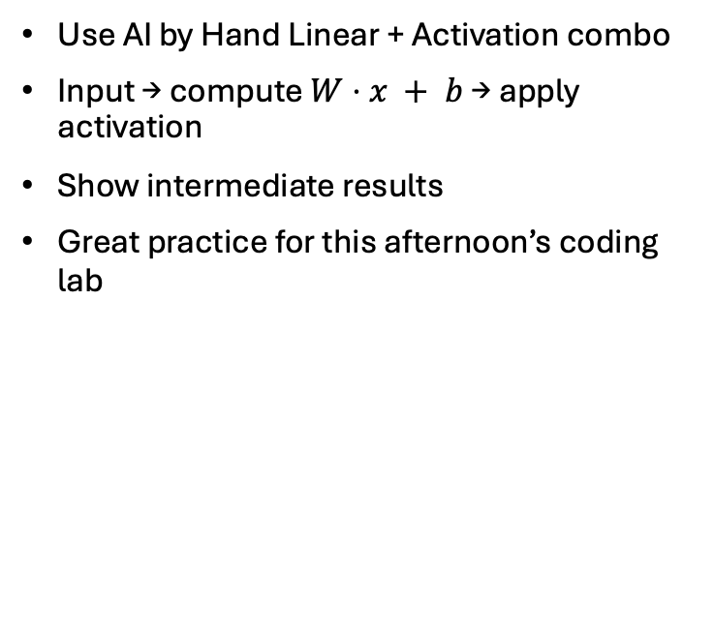
Manual forward pass
Use AI by Hand Linear + Activation combo
Input → compute $W⋅x + b$→ apply activation
Show intermediate results
Great practice for this afternoon’s coding lab

Slide 24
Quiz Time – Check Your Understanding
What happens if bias is zero?
What are the implications of not using an activation function?
How many weights in a 2-layer net with 3 hidden neurons each?

Slide 25
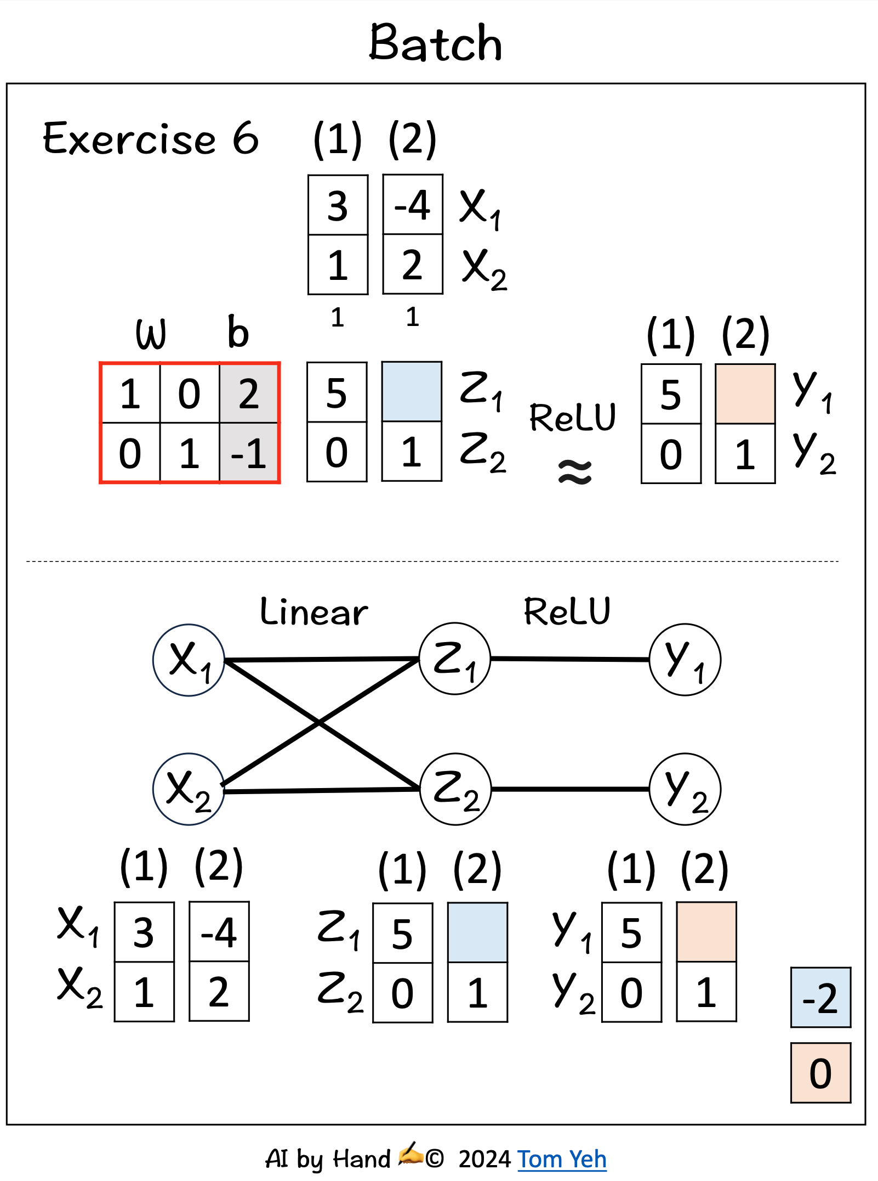
Multi-layered network architecture
In real-world NNs there are many neurons at different layers of the architecture. Each has its own weights and biases
Here Z is a hidden layer with two neurons, each of which has its own weights and biases

Slide 26
A neural network for weather data
Inputs = today’s temperature, humidity, wind speed...
Outputs = tomorrow’s temperature, humidity, wind speed
NNs can learn the spatial and temporal patterns
Next lecture: discover how NNs learn the weights and the biases from data

Slide 27
Common pitfalls
Forgetting bias
Confusing dimensions
Applying wrong (or inappropriate) activation function
Check, check, and check again (and use LLMs)

Slide 28
Next class: training
So far: forward pass only. i.e. taking weights and biases, and getting to the outputs
Next: how do we learn weights?
Concepts of loss, gradients, updates

Slide 29
Summary
A neural network is just a fancy linear regression with extra nodes
These hidden nodes can capture much more flexible behaviour than the basic LR
Most of the (forward) calculations are just matrix multiplication of weights and biases
We use activation functions to allow more flexibility (and especially sparsity) in the way the values are modelled
Tomorrow: how do we estimate the weights?

